Slide 1
NLP

Slide 2
Introduction to NLP
Probabilities

Slide 3
Probabilities in NLP
Very important for language processing
Example in speech recognition:
“recognize speech” vs “wreck a nice beach”
Example in machine translation:
“l’avocat general”: “the attorney general” vs. “the general avocado”
Example in information retrieval:
If a document includes three occurrences of “stir” and one of “rice”, what is the probability that it is a recipe
Probabilities make it possible to combine evidence from multiple sources in a systematic way
Notes:
CHECK EXAMPLES

Slide 4
Probabilities
Probability theory
predicting how likely it is that something will happen
Experiment (trial)
e.g., throwing a coin
Possible outcomes
heads or tails
Sample spaces
discrete (number of occurrences of “rice”) or continuous (e.g., temperature)
Events
Ω is the certain event
∅ is the impossible event
event space - all possible events

Slide 5
Sample Space
Random experiment: an experiment with uncertain outcome
e.g., flipping a coin, picking a word from text
Sample space: all possible outcomes, e.g.,
Tossing 2 fair coins, Ω ={HH, HT, TH, TT}

Slide 6
Events
Event: a subspace of the sample space
E⊆ Ω, E happens iff outcome is in E, e.g.,
E={HH} (all heads)
E={HH,TT} (same face)
Impossible event (∅)
Certain event (Ω)
Probability of Event : 0 ≤ P(E) ≤1, s.t.
P(Ω)=1 (outcome always in Ω)
P(A∪ B)=P(A)+P(B), if (A∩B)=∅ (e.g., A=same face, B=different face)

Slide 7
Example: Toss a Die
Sample space: Ω = {1,2,3,4,5,6}
Fair die:
p(1) = p(2) = p(3) = p(4) = p(5) = p(6) = 1/6
Unfair die: p(1) = 0.3, p(2) = 0.2, ...
N-dimensional die:
Ω = {1, 2, 3, 4, …, N}
Example in modeling text:
Toss a die to decide which word to write in the next position
Ω = {cat, dog, tiger, …}

Slide 8
Example: Flip a Coin
Ω : {Head, Tail}
Fair coin:
p(H) = 0.5, p(T) = 0.5
Unfair coin, e.g.:
p(H) = 0.3, p(T) = 0.7
Flipping two fair coins:
Sample space: {HH, HT, TH, TT}
Example in modeling text:
Flip a coin to decide whether or not to include a word in a document
Sample space = {appear, absence}

Slide 9
Probabilities
Probabilities
numbers between 0 and 1
Probability distribution
distributes a probability mass of 1 throughout the sample space Ω.
Example:
A fair coin is tossed three times.
What is the probability of 3 heads?
What is the probability of 2 heads?

Slide 10
Meaning of probabilities
Frequentist
I threw the coin 10 times and it turned up heads 5 times
Subjective
I am willing to bet 50 cents on heads

Slide 11
Probabilities
Joint probability: P(A∩B), also written as P(A, B)
Conditional Probability: P(B|A)=P(A∩B)/P(A)
P(A∩B) = P(A)P(B|A) = P(B)P(A|B)
So, P(A|B) = P(B|A)P(A)/P(B) (Bayes’ Rule)
For independent events, P(A∩B) = P(A)P(B), so P(A|B)=P(A)
Total probability: If A₁, …, A_{n} form a partition of S, then
P(B) = P(B∩S) = P(B, A₁) + … + P(B, A_{n}) (why?)
So, P(A_{i}|B) = P(B|A_{i})P(A_{i})/P(B) = P(B|A_{i})P(A_{i})/[P(B|A₁)P(A₁)+…+P(B|A_{n})P(A_{n})]
This allows us to compute P(A_{i}|B) based on P(B|A_{i})

Slide 12
Conditional Probability
Prior and posterior probability
Conditional probability
P(A ∩ B)
P(A|B) =
P(B)
Ω
A
B
A∩B

Slide 13
Properties of Probabilities
p(∅) = 0
P(certain event)=1
p(X) ≤ p(Y), if X ⊆ Y
p(X ∪ Y) = p(X) + p(Y), if X ∩ Y=∅

Slide 14
Conditional Probability
Six-sided fair die
P(D even)=?
P(D>=4)=?
P(D even|D>=4)=?
P(D odd|D>=4)=?
Multiple conditions
P(D odd|D>=4, D<=5)=?

Slide 15
Answers
Six-sided fair die
P(D even)=3/6=1/2
P(D>=4)=3/6=1/2
P(D even|D>=4)=2/3
P(D odd|D>=4)=1/3
Multiple conditions
P(D odd|D>=4, D<=5)=1/2

Slide 16
The Chain Rule
P(w₁,w₂,w₃…w_{n}) = ?
Using the chain rule:
P(w₁,w₂,w₃…w_{n}) =P(w₁) P(w₂|w₁) P(w₃|w₁,w₂)… P(w_{n}|w₁,w₂…w_{n-1})
This rule is used in many ways in statistical NLP, more specifically in Markov Models
Notes:
Markov property: The probability of the current word only depends on the previous word(s) (one word in unigram model, two words in bigram model, there words in trigram model, etc.)

Slide 17
Independence
Two events are independent when
P(A∩B) = P(A)P(B)
Unless P(B)=0 this is equivalent to saying that
P(A) = P(A|B)
If two events are not independent, they are considered dependent

Slide 18
Adding vs. Removing Constraints
Adding constraints
P(walk=yes|weather=nice)
P(walk=yes|weather=nice,freetime=yes,crowded=yes)
More accurate
But more difficult to estimate
Removing constraints (Backoff)
P(walk=yes|weather=nice,freetime=yes,crowded=yes)
P(walk=yes|weather=nice,freetime=yes)
P(walk=yes|weather=nice)
Note that it is not possible to do backoff on the left hand side of the conditional
[Example modified from Jason Eisner]

Slide 19
Random Variables
Simply a function:
The numbers are generated by a stochastic process with a certain probability distribution
Example
the discrete random variable X that is the sum of the faces of two randomly thrown fair dice
Probability mass function (pmf) which gives the probability that the random variable has different numeric values:
X: Ω → R^{n}
P(x) = P(X = x) = P(A_{x}) where A_{x} = {ω ∈ Ω : X(ω) = x}

Slide 20
Random Variables
If a random variable X is distributed according to the pmf p(x), then we write X ~ p(x)
For a discrete random variable, we have
Σp(x_{i}) = P(Ω) = 1

Slide 21
Six-sided Fair Die
p(1) = 1/6
p(2) = 1/6
etc.
P(D)=?
P(D) = {1/6, 1/6, 1/6, 1/6, 1/6, 1/6}
P(D|odd) = {1/3, 0, 1/3, 0, 1/3, 0}

Slide 22
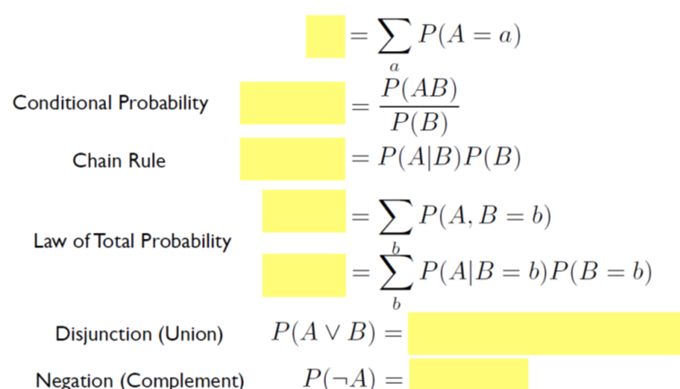
Probability Review
[slide from Brendan O’Connor]

Slide 23
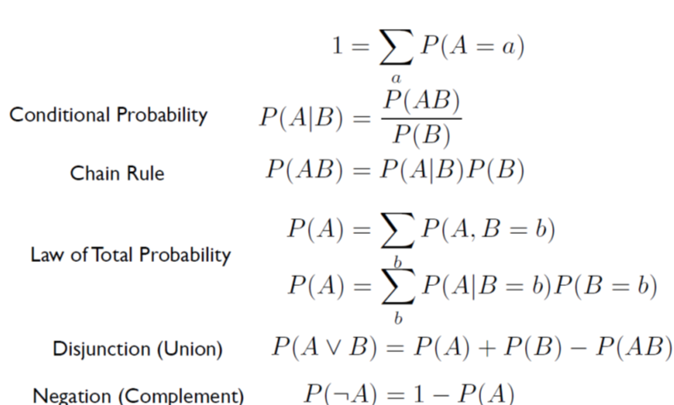
Probability Review 2/2
[slide from Brendan O’Connor]

Slide 24
NLP

